Slide 1

Data In, VVisdom Out
Contributors
Shashank Udgirkar 31384
Shubham Chemate 31118
Guide
Prof. M. S. Wakode
Mentors
Akhilesh Moghe
Hemant Acharya
Dinesh Vyas

Slide 2
Contents
Problem Statement
Introduction
Algorithmic Details
Outcomes of Internship
Achievements
Future Scope

Slide 3

The Challenge as we understand
Emerging Financial Crimes
Limited IT Spend For Compliance
Covid-Outburst & Digital Revolution
New Ways to commit Fraud
Sophisticated avenues to launder Money
Fixed Budget
Limited Workforce
Time taking investigations
cost of Non- Compliance
Repetitive Activities
Penalties from Regulator
Credibility Risk
Adverse Impact customer-base
Mundane investigation for similar Alerts
Mechanic Events during investigation
Inconsistent human behavior
High Open Rates, due to lack of right experience

Slide 4
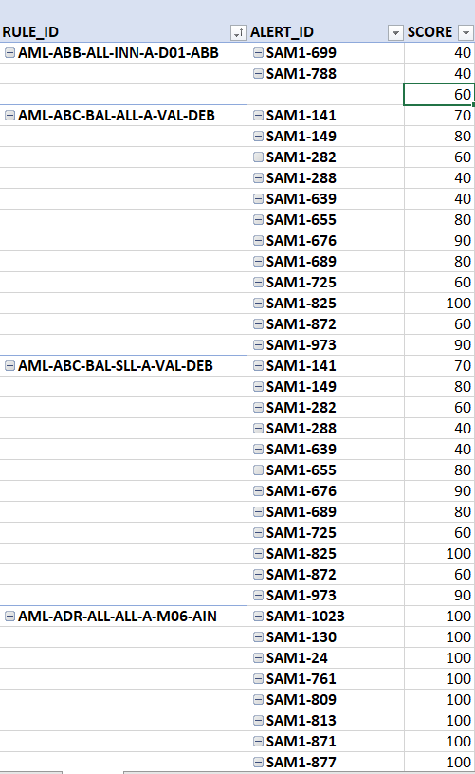

Mining Patterns, To Build Wisdom
Alert Types
Workflow
Steps
Satisfied Rules
Similarity
Alert Closed as Suspicious
Patterns

Slide 5

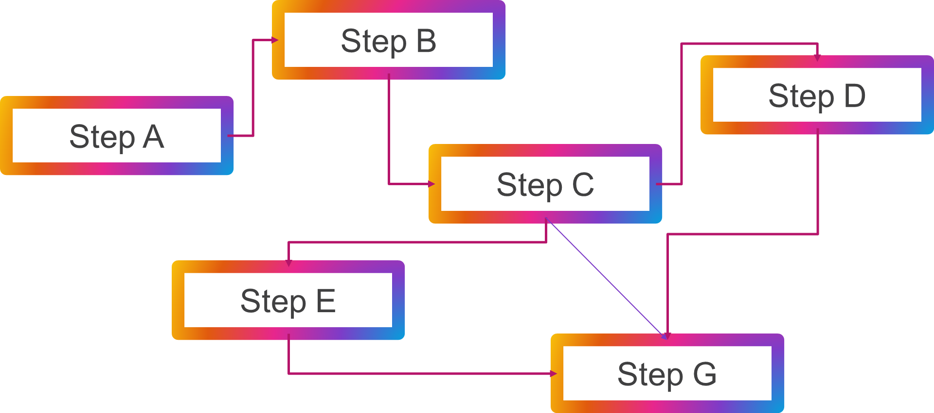
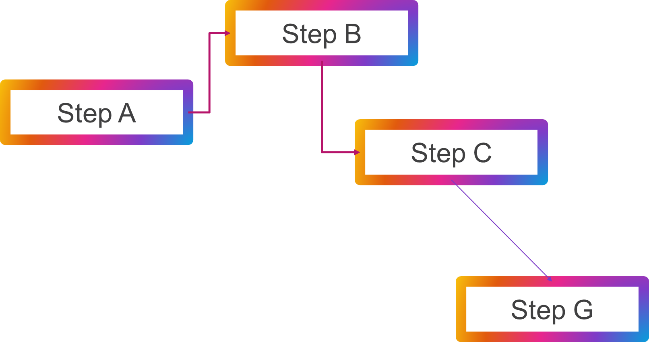

INTRODUCTION
Money Laundering Alert
Robert
Fraud Alert
Lisa
Money Laundering Alert
Arturito
Money Laundering Alert
Tokyo

Slide 6
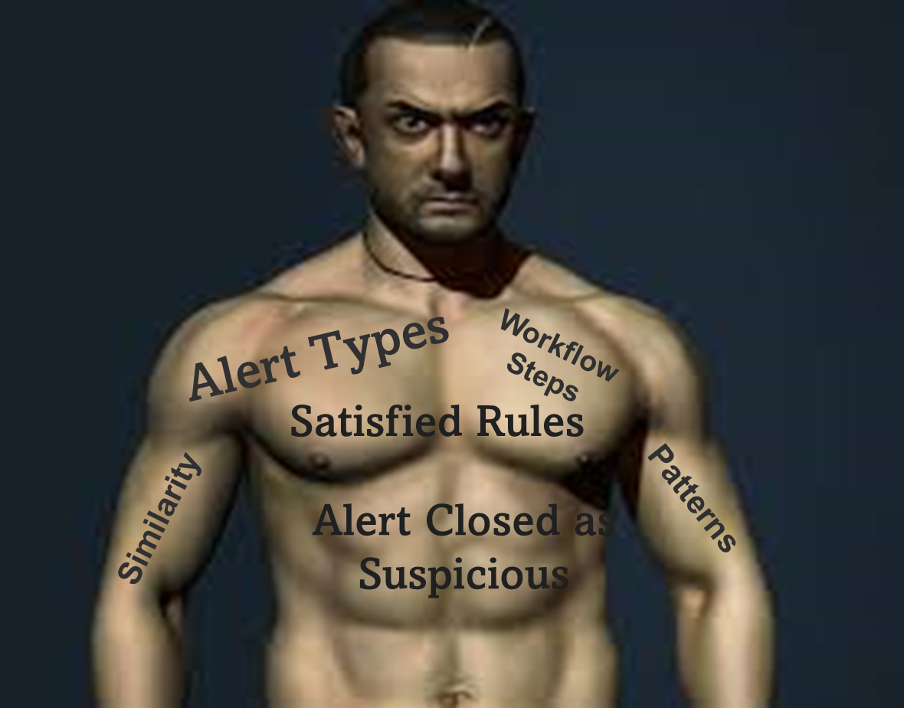
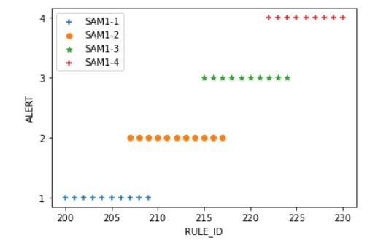
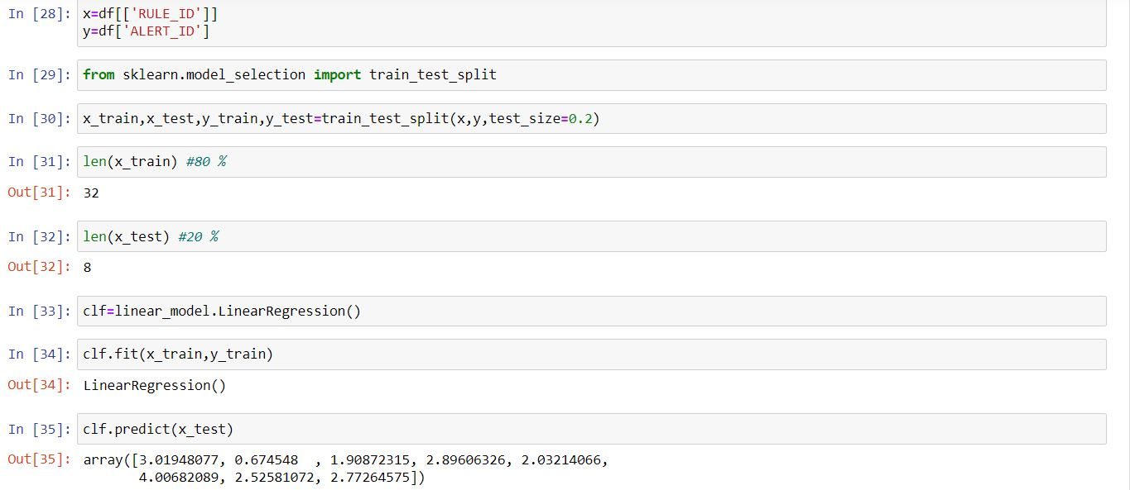
Solving it in a Scaled Manner — Algorithmic Details
Data-IN
Understanding Data-Set
Tagging Data
Process
Data Clean-Up
Standardization
Apply Intelligence
Model-Driven parsing
Pattern Identification
Wisdom-Out
Predict Next Best-Step
Provide Recommendation to Investigator

Slide 7
Activities planned to be completed during coming weeks (Outcomes)
Tuning the Model further to capture dynamic/configurable features
Verifying the Model on larger data-set
Developing Plugins for the Upstream to leverage the Wisdom
Integrating the Model with Actimize Case Manager

Slide 8
Foreseen Benefits (Achievements)
Guided Investigation
Cost Saving
ML Recommendations to take the next-best Step
Consistent approach
Reduction in Time-Spent in reviewing similar events
Reduced Re-Opens
Credibility Enhancement
Increased Focus
Reduced Penalties from Regulator
Improved Credibility
And, enhance customer Experience
Investigator can now focus on more specific enrichment

Slide 9
Future Scope
As we are building a model which will predict the workflow of new alert generated depending on the previous existing data we can reduce the time of investigation upto70% and also increases the efficiency of investigation process.
Also we are developing a generalize plugin or extension so that any organization can used it for detecting any fraud and to predict the next best step of investigation.

Slide 10
Views/Questions?

